Slide 1







ONLINE STORYTELLING
for promoting cultural heritage
Smartphone photography workshop - how to take a photo that tells a story
M4W1

Slide 2
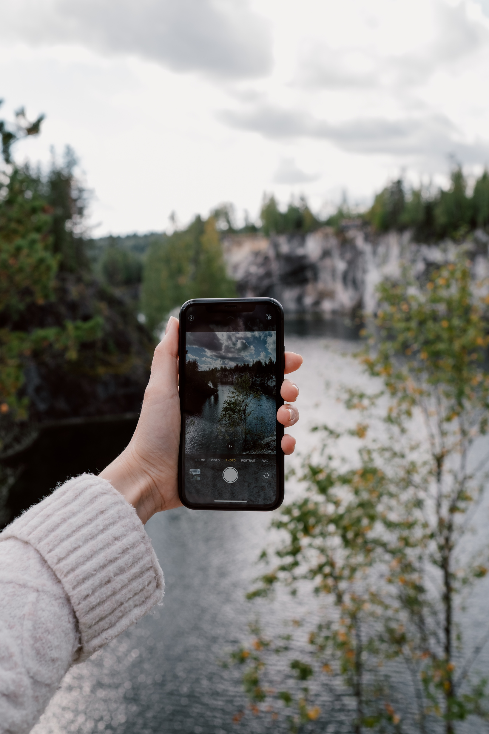

Stage 1: What is mobile photography - a brief history

Slide 3
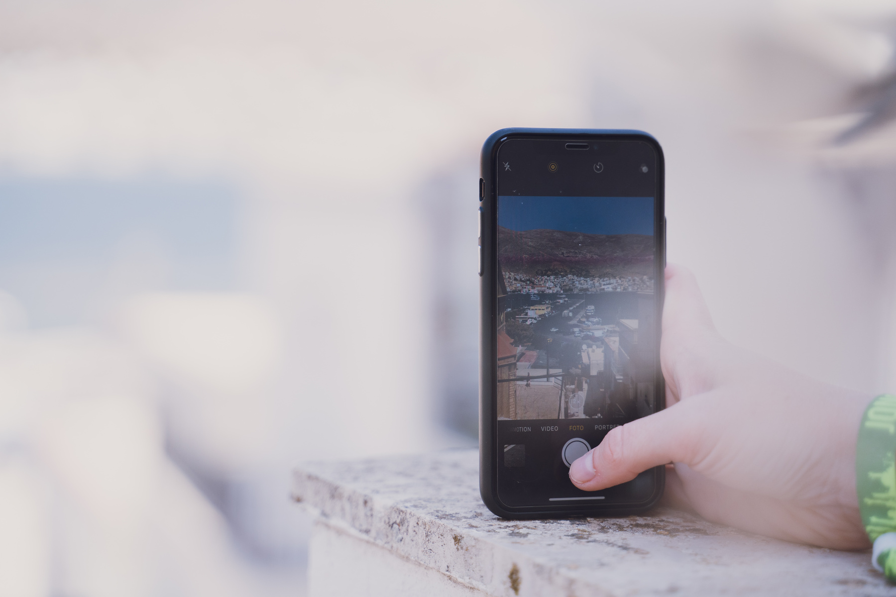
Mobile photography
is the conscious and planned creative process of taking photographs using a mobile device, such as a smartphone or tablet

Slide 4
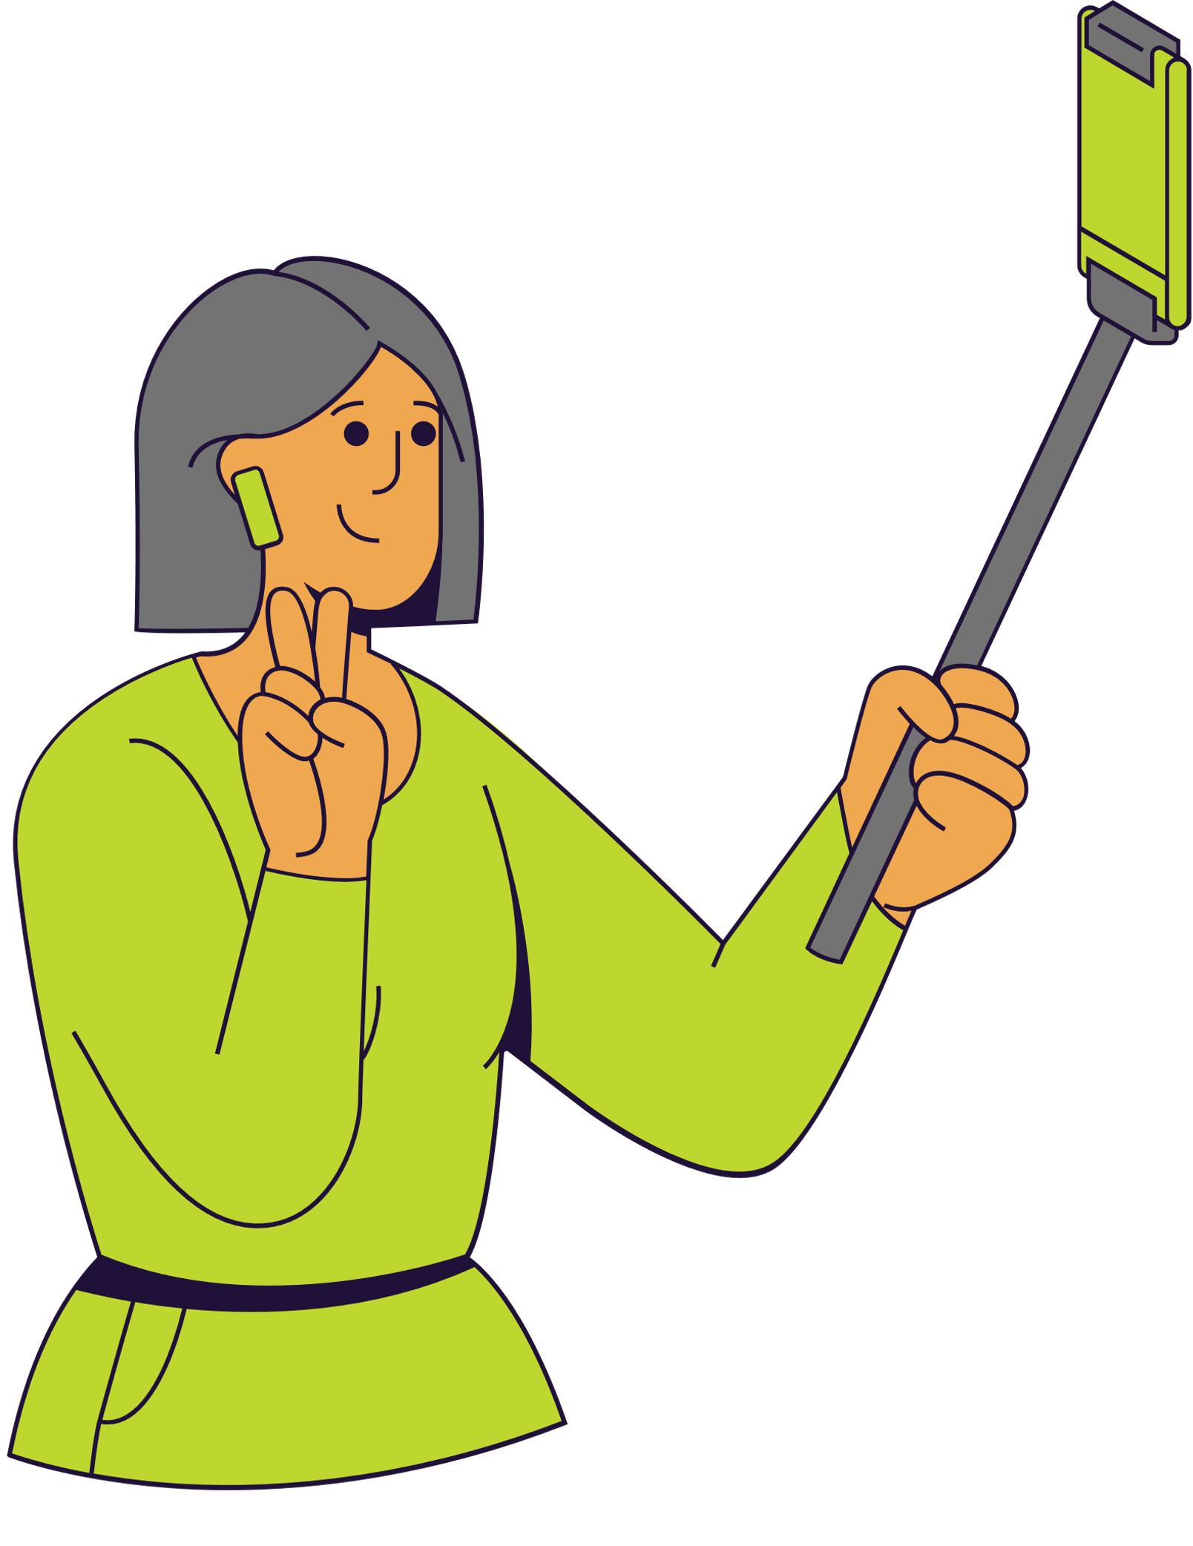
The creative proces is all about the person taking the photo, not the smartphone or tablet

Slide 5
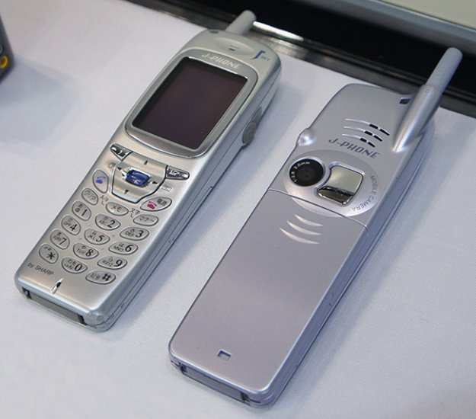
The first phone with a camera was Samsung. The device appeared in South Korea in 2000.
https://www.pcformat.pl/News-Pierwsza-komorka-z-aparatem-fotograficznym,n,23715

Slide 6


The revolution in image sharing has come with the rise of social media. In 2003, LinkedIn and MySpace were created.

Slide 7




2004
2005
2006
2010

Slide 8
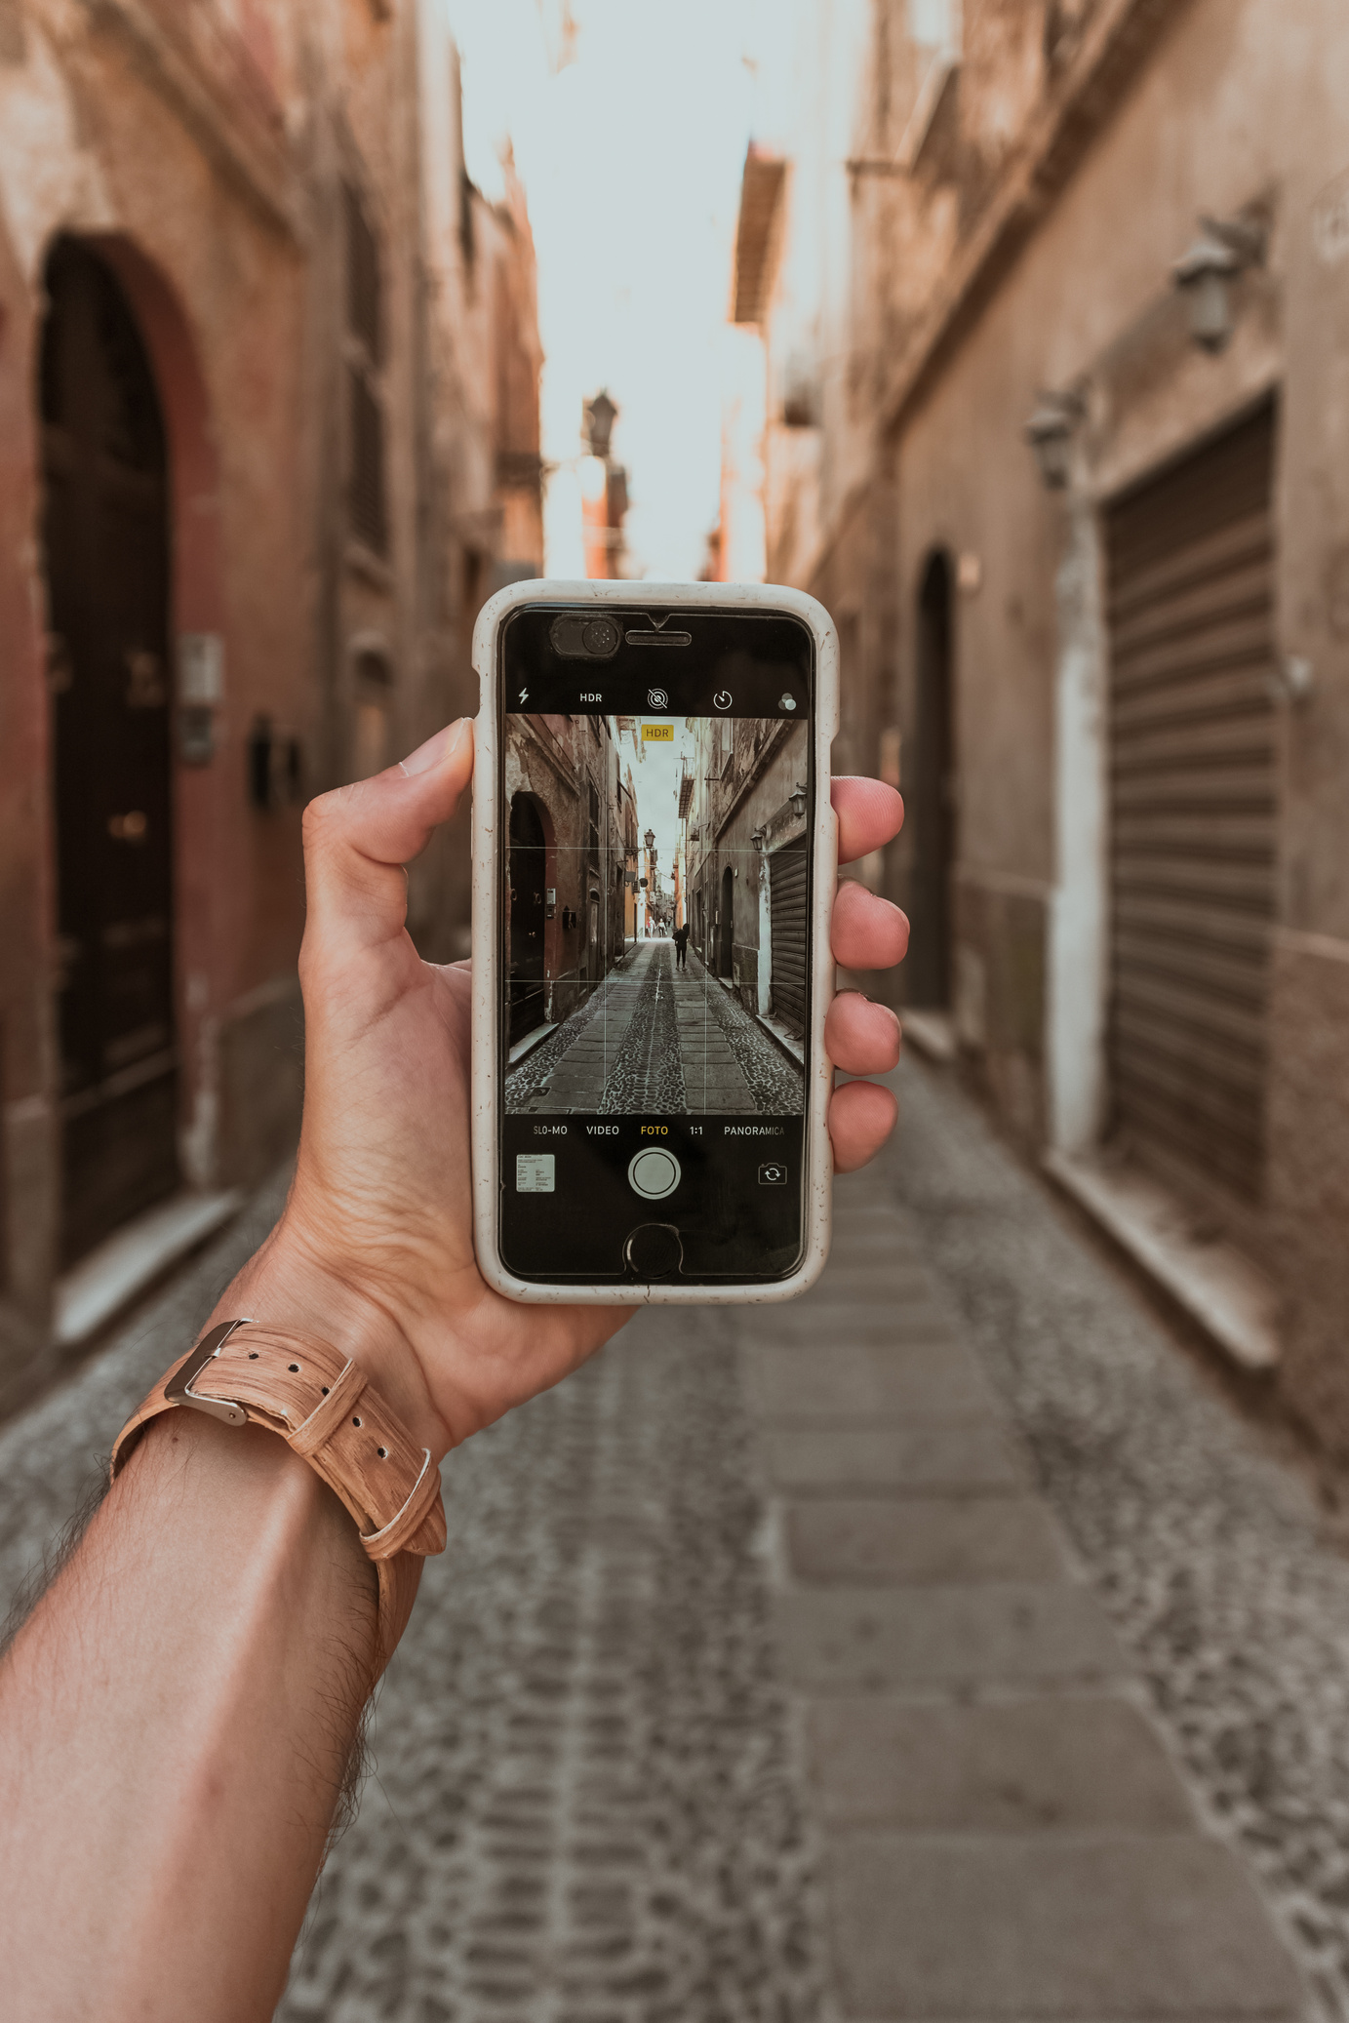
Stage 2: Basic framing and the role of light in photography

Slide 9
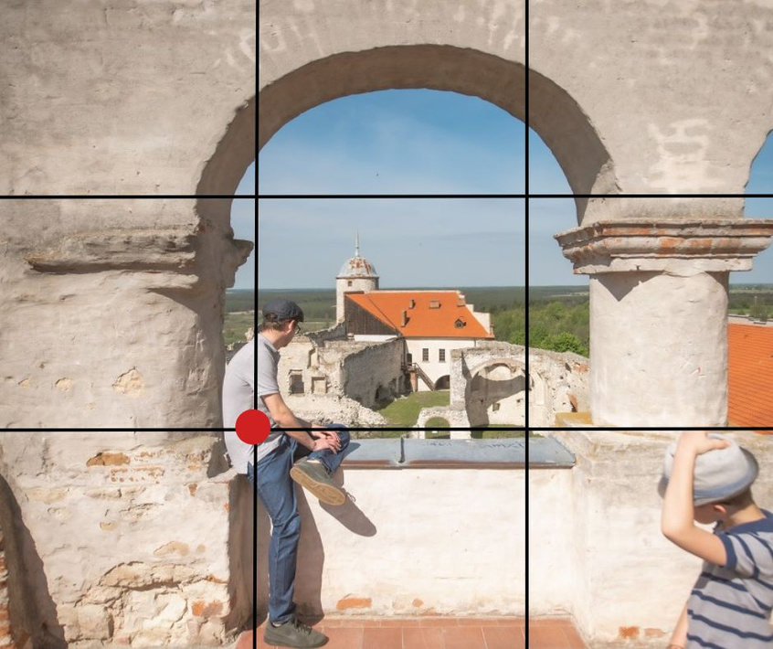

Light and composition are key.
Before taking a photograph, think about how best to frame given situation.

Slide 10
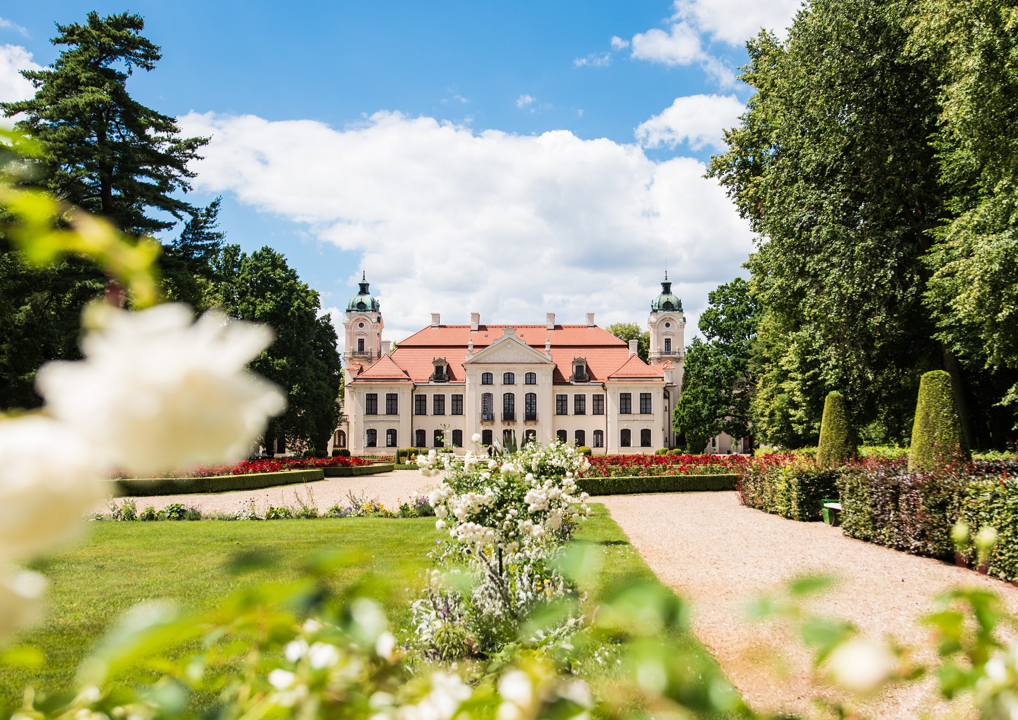
Central composition

Slide 11
Central composition
Emphasises the importance of the main object and creates an impression of order and balance.

Slide 12
Rule of tri-partition

Slide 13
Rule of tri-partition
Four lines divide the frame into nine equal rectangles.The points where the lines intersect are known as the strong points, where the most important elements of the photo should be placed.elementy zdjęcia.

Slide 14
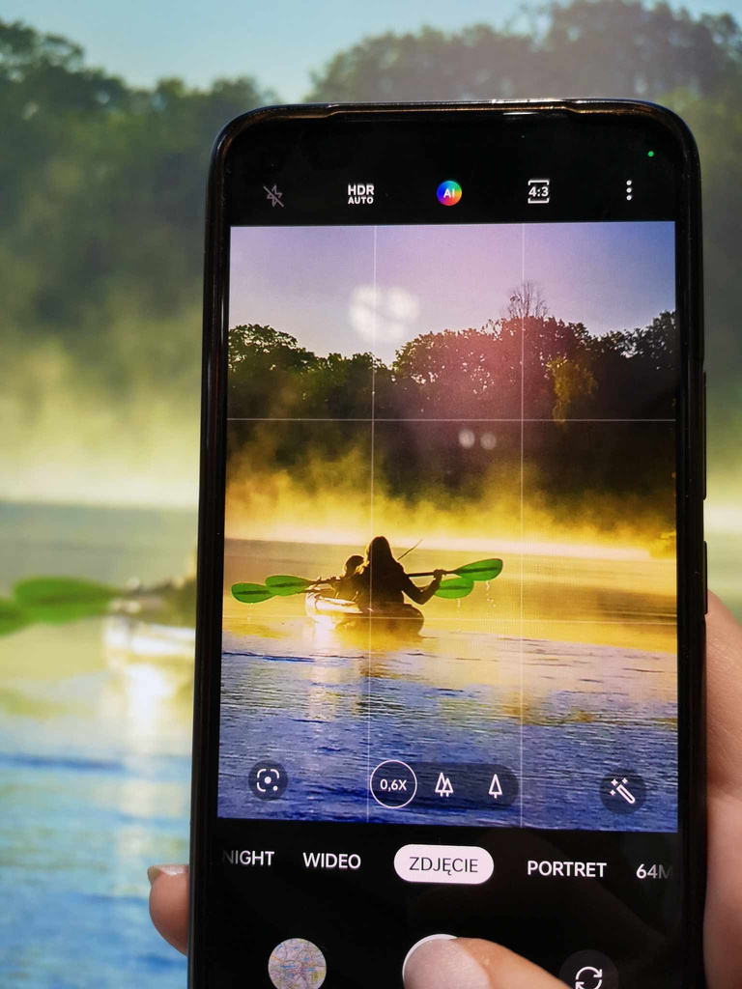
Turning on the tri-partition grid
in the camera settings is a good way to improve framing

Slide 15
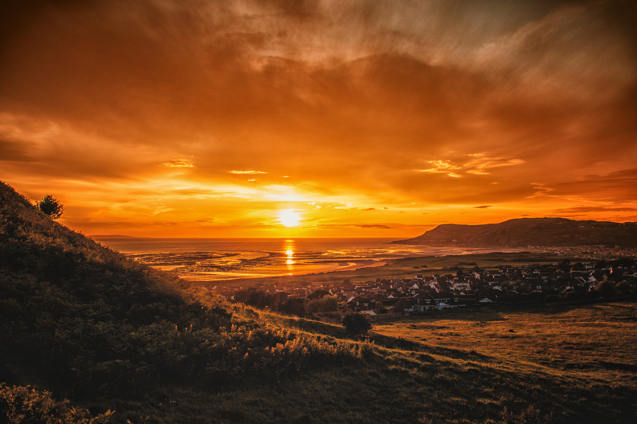
Golden hour is when sunlight gives the environment a warm hue

Slide 16

Golden hour is the moment accompanying the rising of the sun, the time during and just after sunrise, but also the moment just before and during sunset

Slide 17
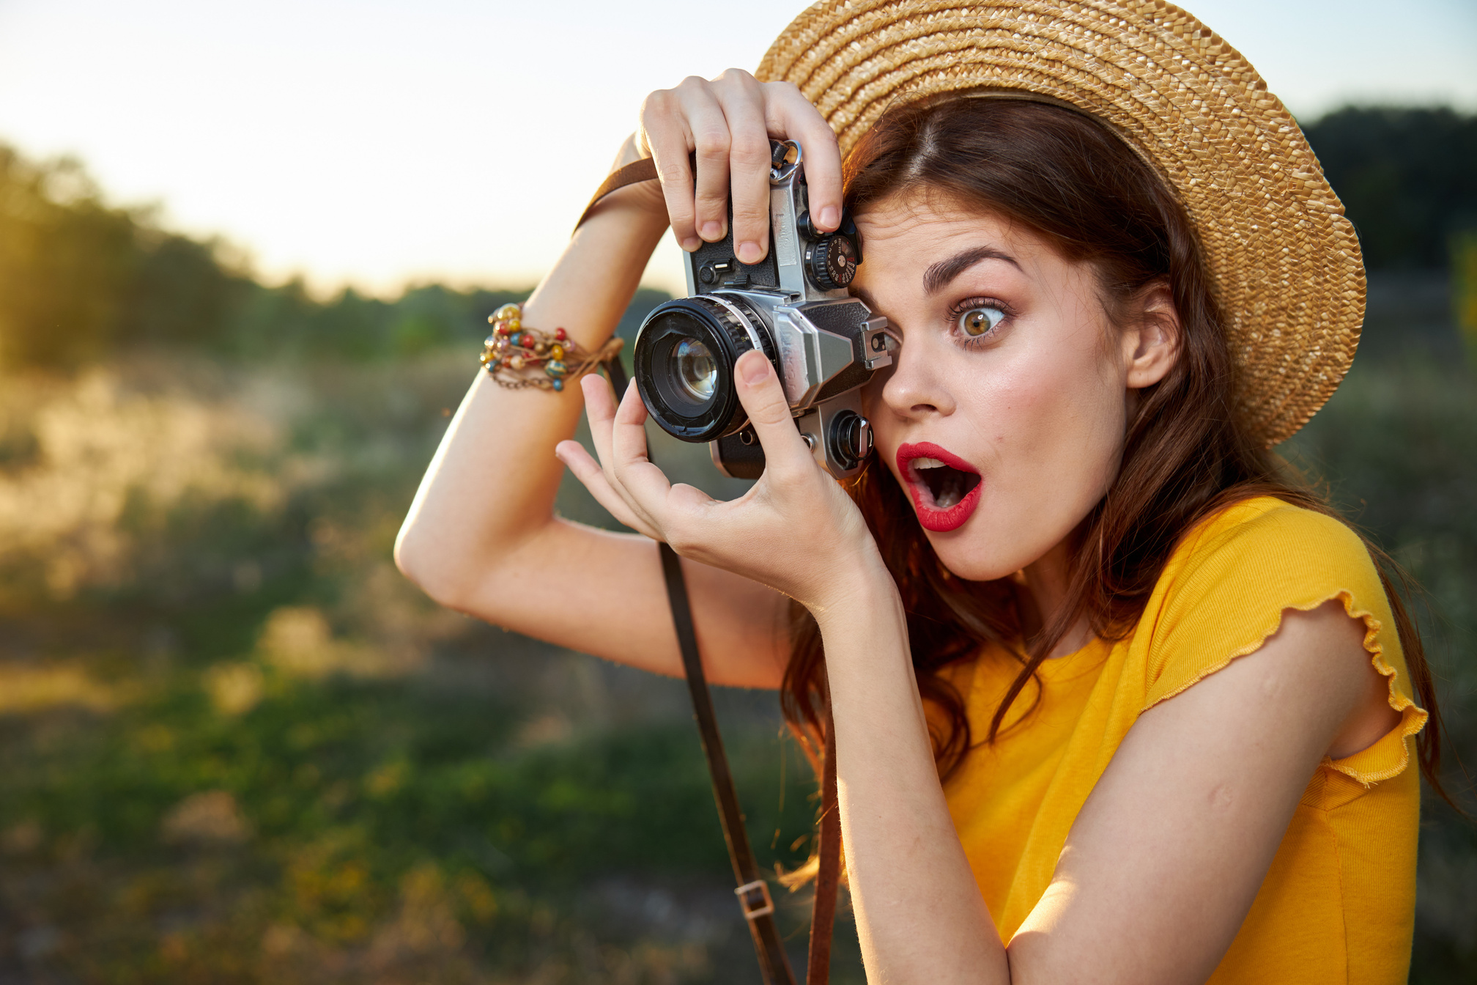
Don't shoot against the sun
- position yourself so that you have the light behind you, or even, preferably, from the side

Slide 18


Use additional light sources
- e.g. streetlights or the flash from your phone's camera

Slide 19
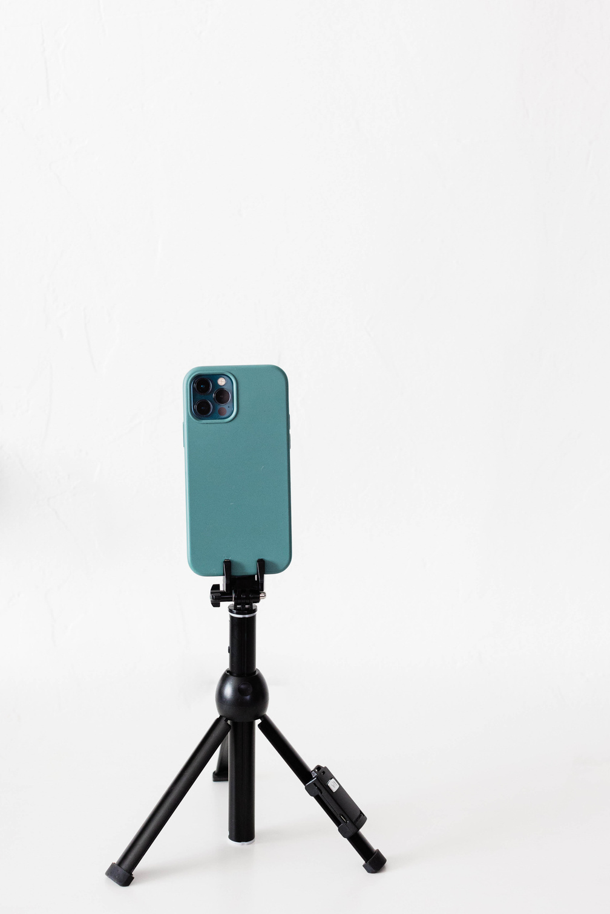
Image stabilisation
Most smartphones are equipped with function of image stabilisation.

Slide 20


Image stabilisation
When taking a photo with the help of a tripod, it is worth using the self-timer function, which will additionally stabilise the image.

Slide 21
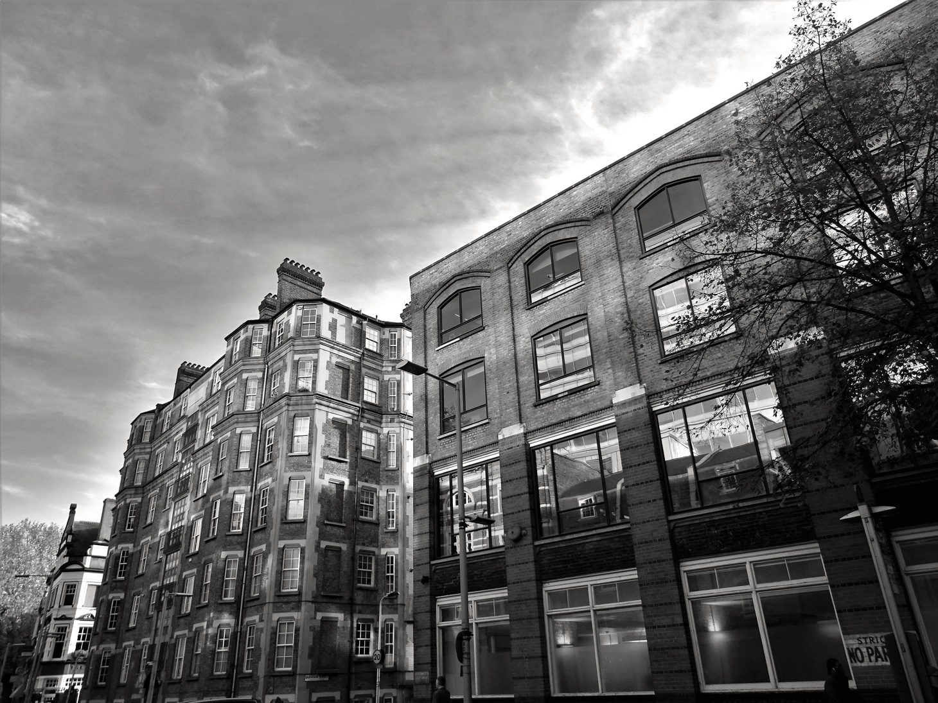
Stage 3: Creative functions of smartphone cameras

Slide 22
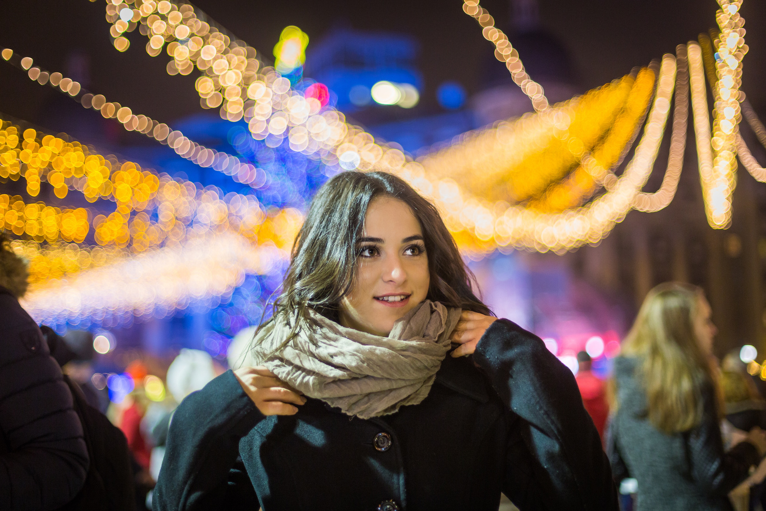
Portrait with bokeh effect
Use the "Portrait" function, take close-up shots, increase the distance between subject and background

Slide 23
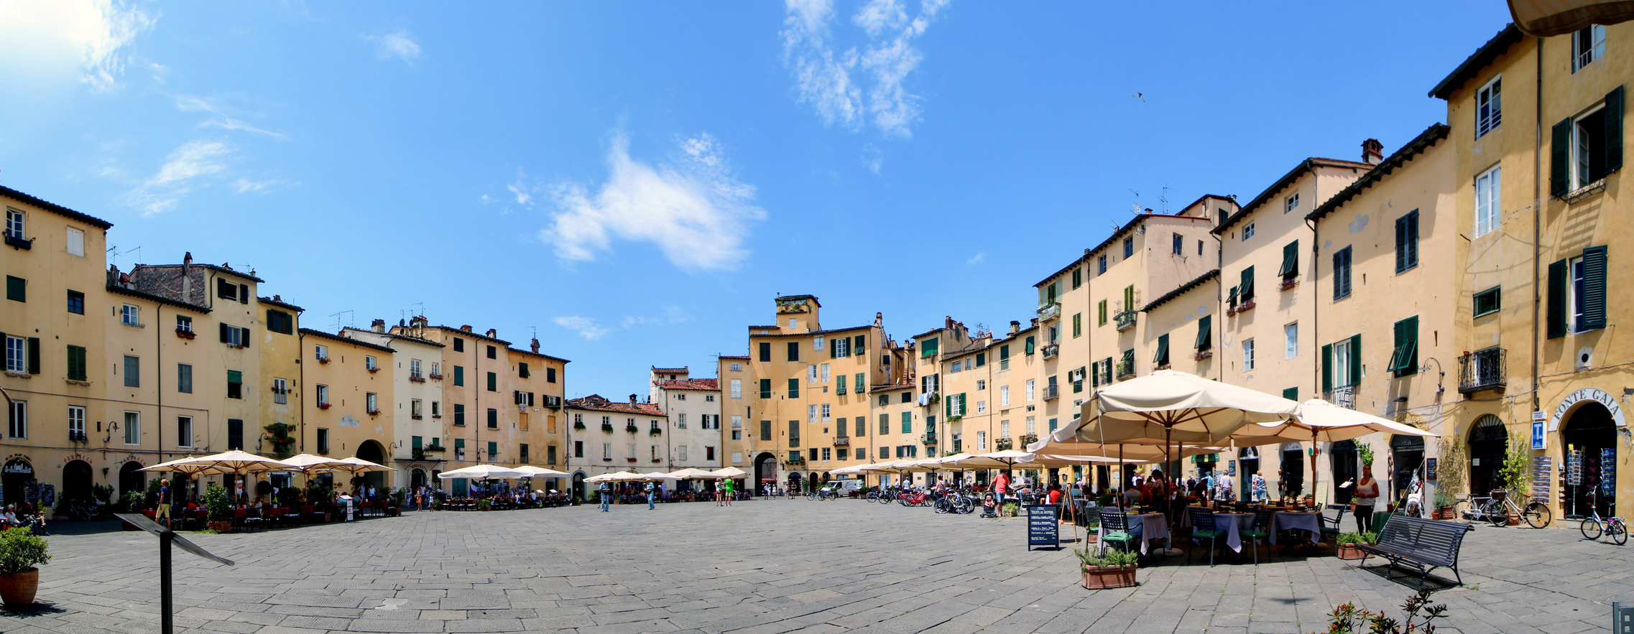

Panorama
The panorama mode is useful when we want to capture an area in a photo that is wider or higher than the area that our camera frame covers.

Slide 24
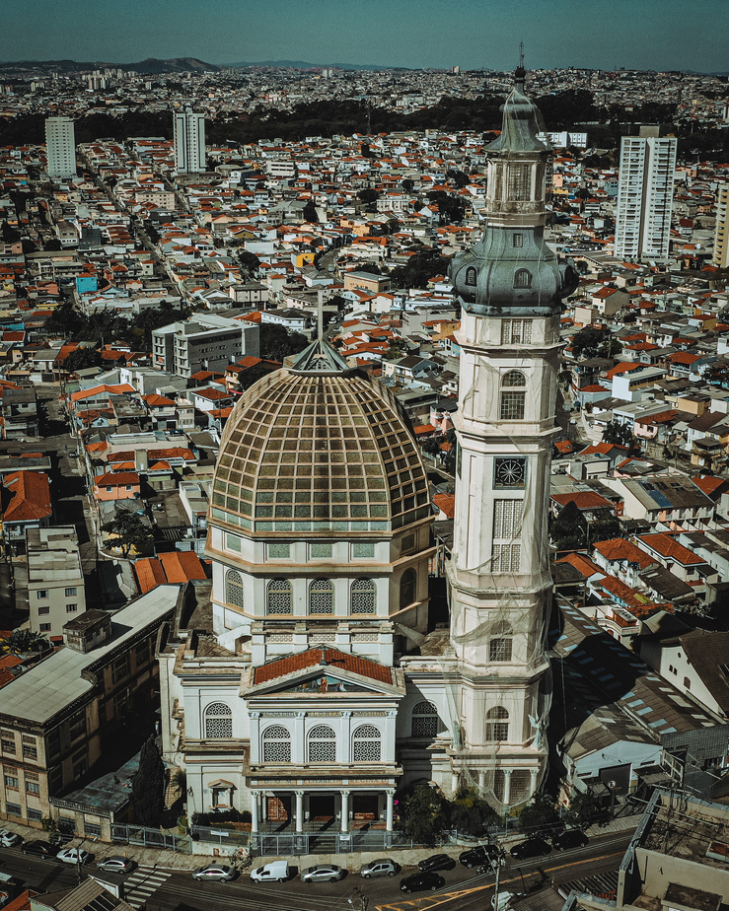
Panorama mode can also be used vertically

Slide 25
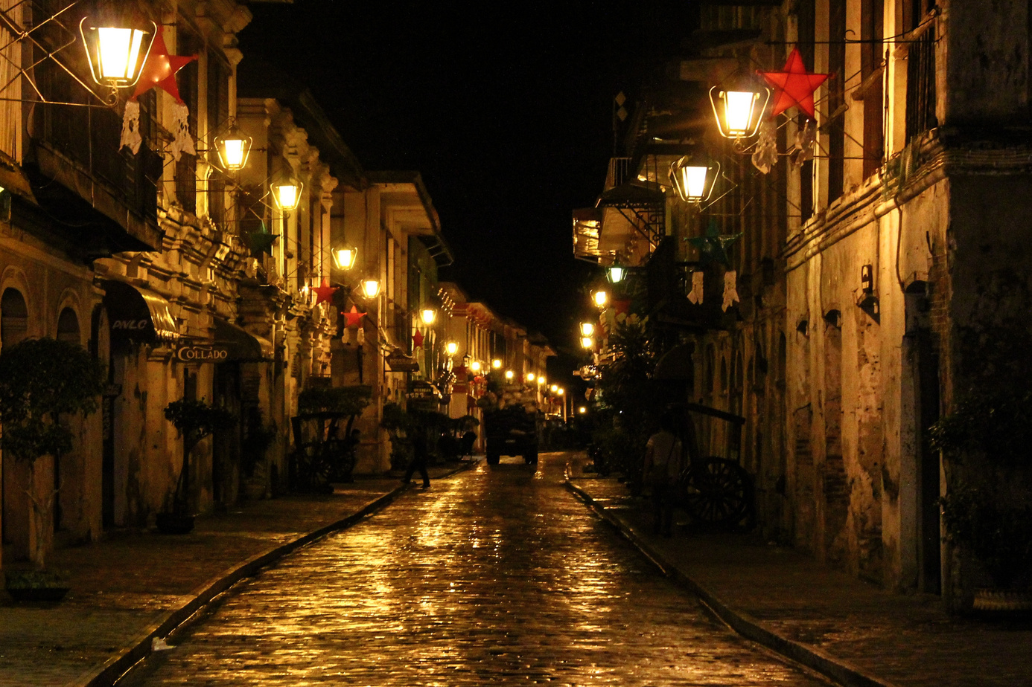
Night shots
Turn on the night mode, look for light that illuminates the frame (e.g. streetlights), use a tripod or other form of phone stabilisation to stabilise your phone

Slide 26
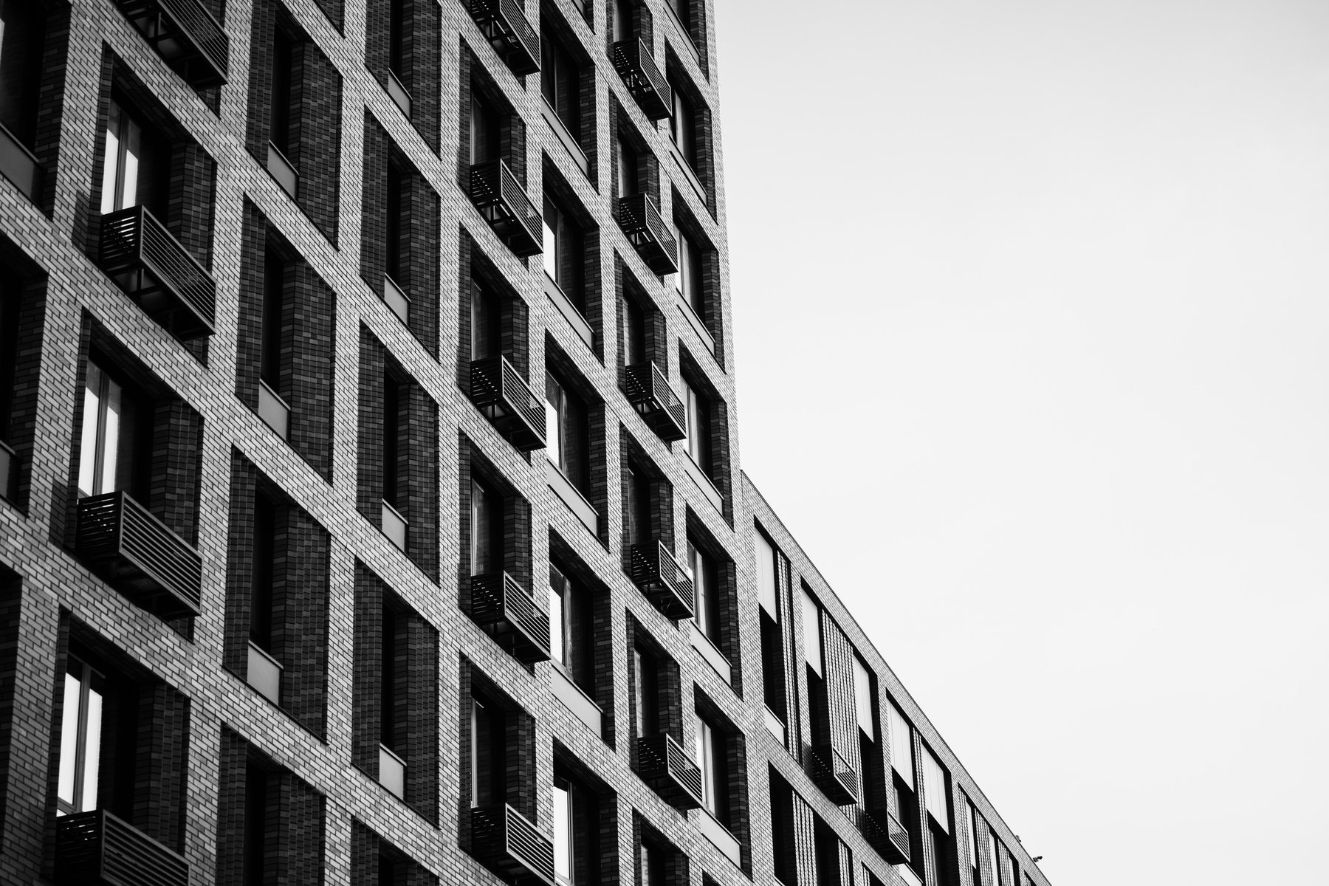
Black & white photos
  highlights the shape of buildings and other urban infrastructure objects
  is ideal for portraits
  the most important element of black and white photographs is their contrast and the chiaroscuro impact

Slide 27
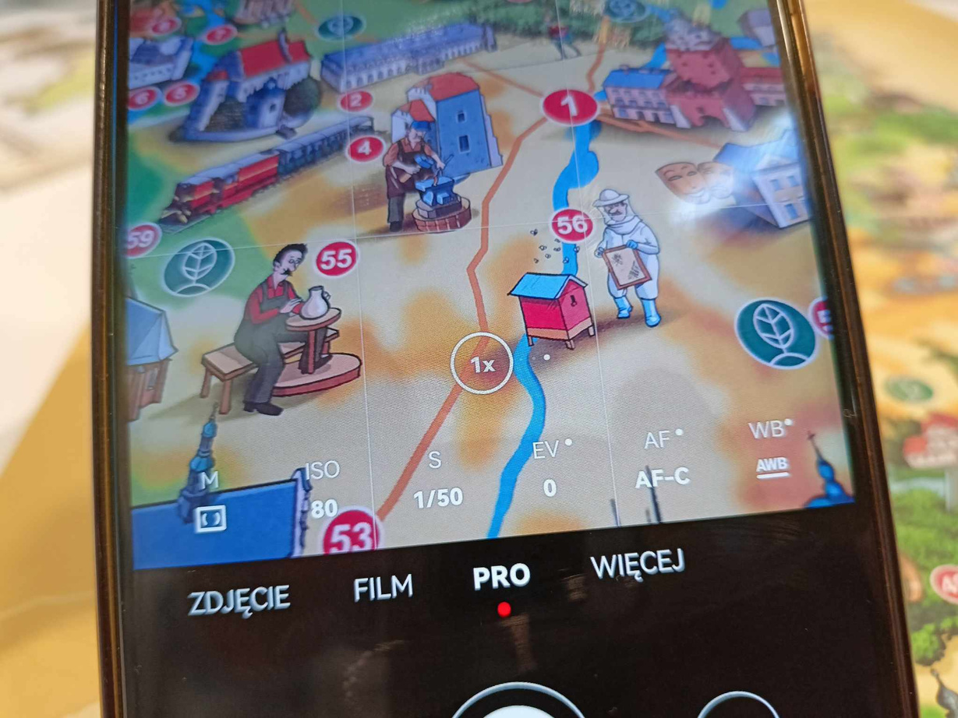
Manual settings - PRO

Slide 28

ISO
  By setting the ISO correctly, you can achieve good image quality by letting in just the right amount of light
  High ISO increases the camera's sensitivity to light, which works well in low-light areas
  Low ISO values are suitable for well-lit scenes

Slide 29
S
  "S" stands for Shutter
  Adjustment allows you to change the shutter speed, i.e. the exposure
  When you want a blur-free picture, set a fast exposure time (e.g. for hand-held photography).
  A long exposure time can give an interesting effect, but the photos will be heavily blurred, so it's best to use a tripod

Slide 30
EV
  EV is the exposure value of the photo
  The lower the exposure value, the darker the frame will be
  The higher the exposure value, the brighter the photo will be

Slide 31
Smartphone apps
  If you are not satisfied with the results, you can edit your photos using the free applications
  Functions include image straightening and cropping, contrast, colour saturation, brightening and darkening, or the use of filters
  Do not over-edit - moderation is important

Slide 32



Smartphone apps
Snapseed
Lightroom
PicsArt

Slide 33
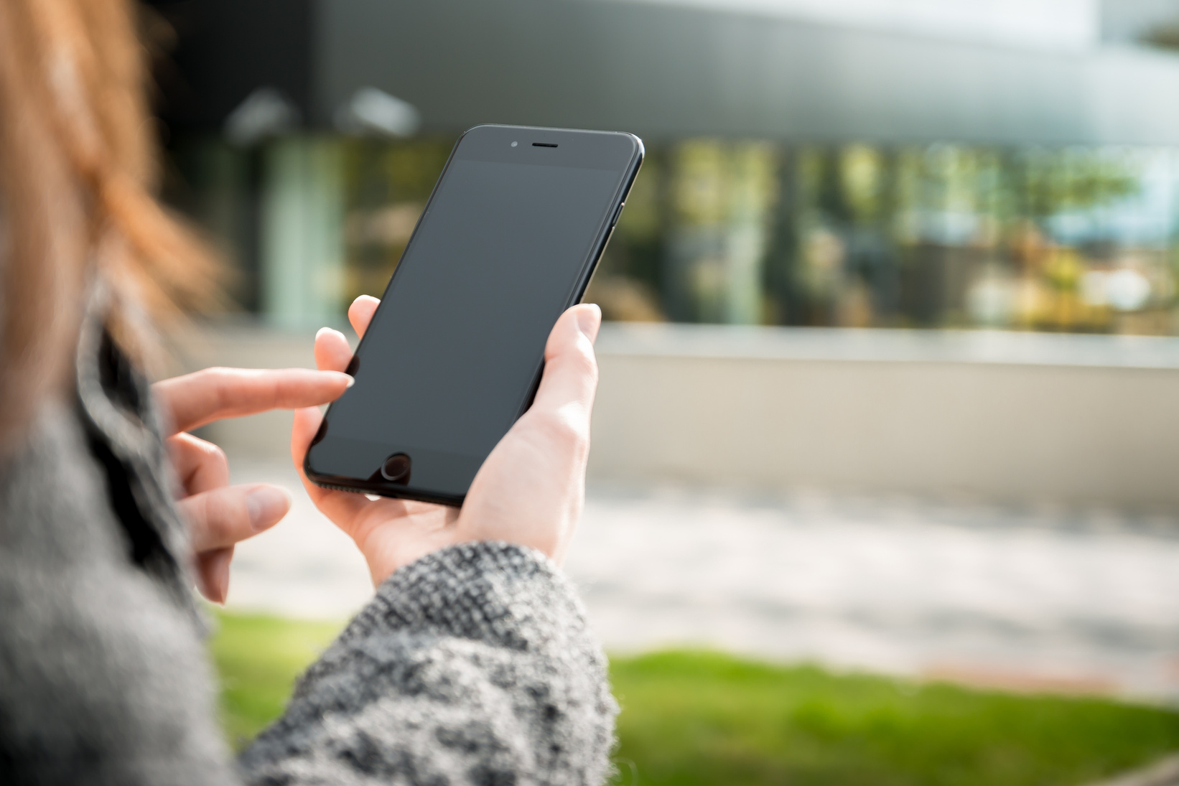
Stage 4: Practical exercise of taking photos with a smartphone

Slide 34


Draw and perform a task

Slide 35
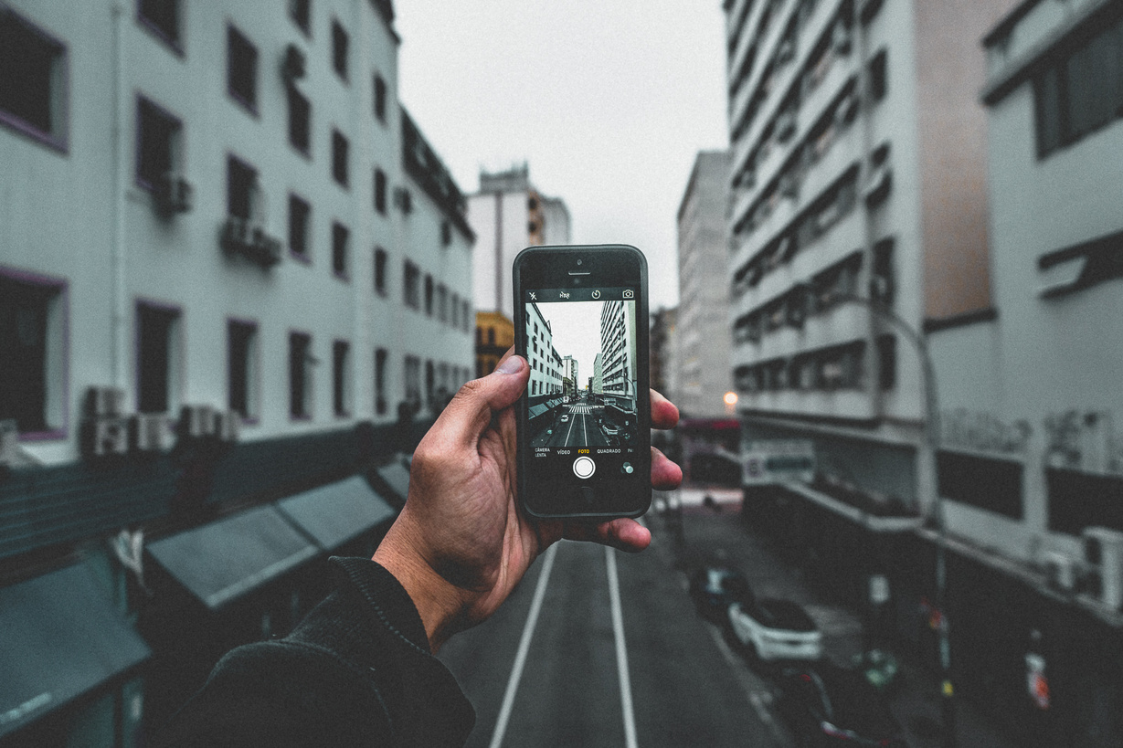
Stage 5: Summary and conclusion

Slide 36


Give yourself a moment to think about the frame concept before you take the picture

Slide 37

Consider appropriate composition

Slide 38

Use natural light - it is the best "painter of images"

Slide 39

Try to stabilise the image

Slide 40

Use the phone's additional camera functions

Slide 41

If you are not satisfied with the result of a photograph you have taken, you have many tools at your disposal to edit it

Slide 42

Do not over-edit (!)

Slide 43

It pays to be creative

Slide 44

Thank you!

Slide 45


